Slide 1


NUTRI LENS AI
KORRA PREM KUMAR
[24BK1A66BM]
NIRANJAN SINGH
[24BK1A66BX]
PRINCE PATEL
[24BK1A66CH]

Slide 2
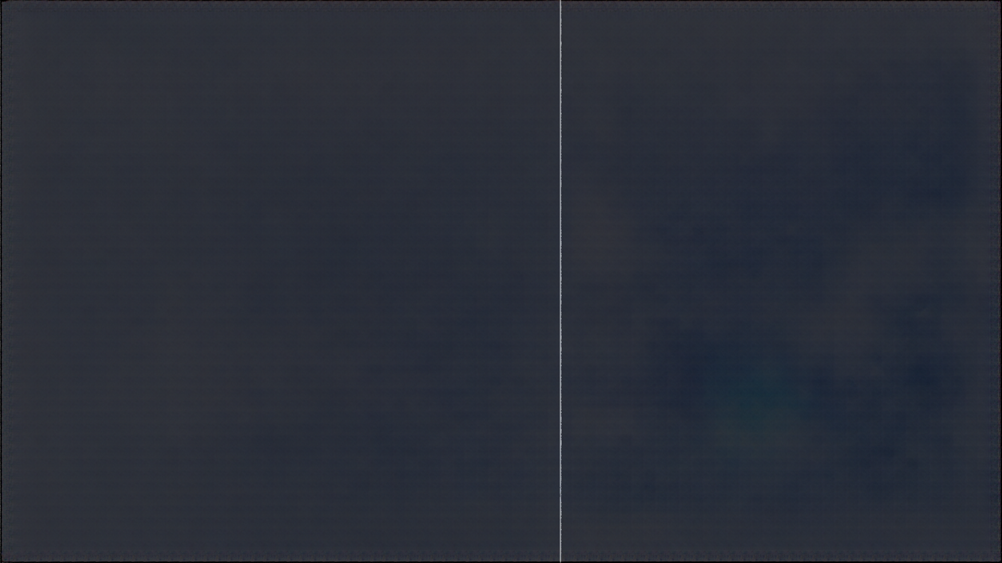

Domain of the Project
Primary domain
  ARTIFICIAL INTELLIGENCE (AI) AND MACHINE LEARNING (ML)
AI/ML ENABLES NUTRI LENS AI TO ANALYZE FOOD INGREDIENTS AND RECOMMEND HEALTHIER FOOD CHOICES.

Slide 3
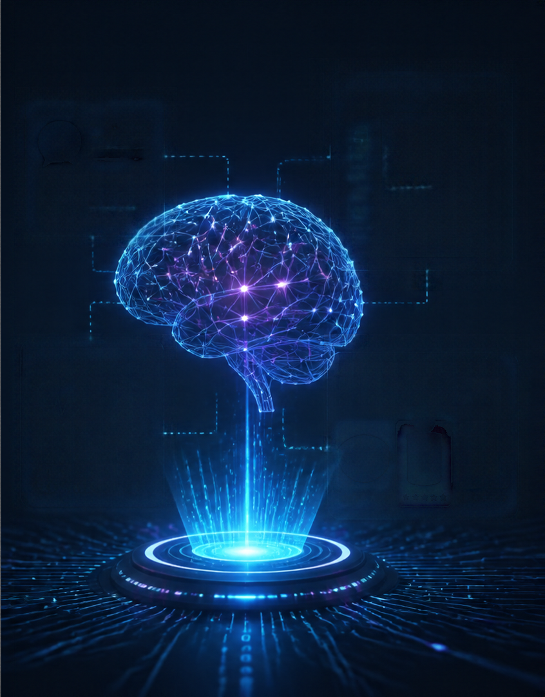
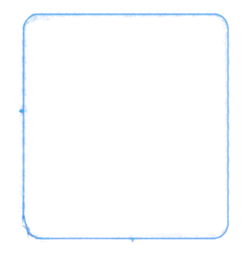
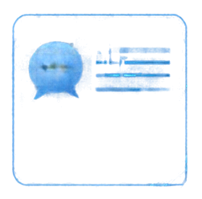
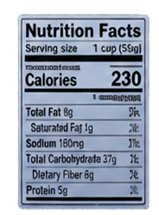

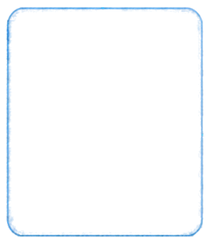
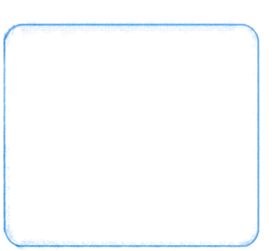


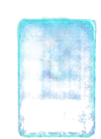


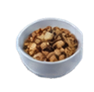







Domain of the project
COMPUTER VISION / OCR
NLP
"Low sodium" "High in fiber"
SECONDARY DOMAIN
  NATURAL LANGUAGE PROCESSING (NLP): TO ANALYZE INGREDIENTS AND GENERATE UNDERSTANDABLE EXPLANATIONS.
  COMPUTER VISION AND OCR: TO EXTRACT TEXT FROM FOOD-LABEL IMAGES.
  HEALTH INFORMATICS: TO ORGANIZE AND INTERPRET NUTRITIONAL INFORMATION.
  RECOMMENDATION SYSTEMS: TO SUGGEST ALTERNATIVE FOOD PRODUCTS BASED ON NUTRITIONAL CRITERIA AND USER PREFERENCES.
HEALTH INFORMATICS
RECOMMENDATION SYSTEMS
4

Slide 4
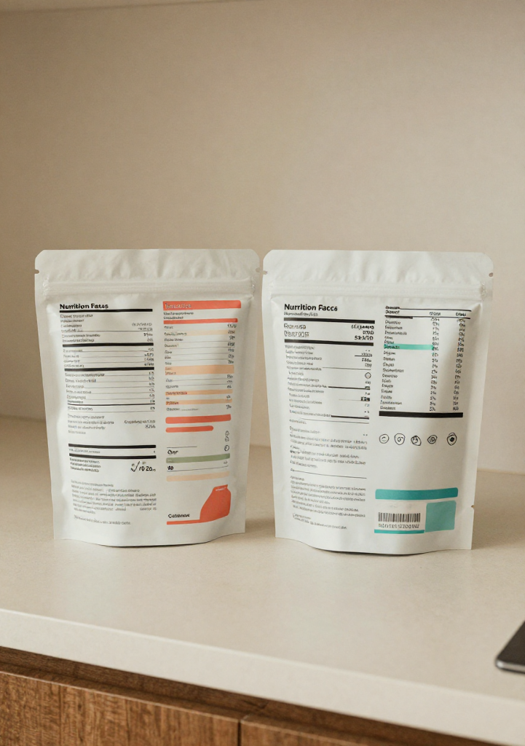
Problem Statement
  CONSUMERS STRUGGLE TO UNDERSTAND COMPLEX INGREDIENT LISTS ON PACKAGED FOODS.
  HIDDEN SUGARS, EXCESS SODIUM, AND UNHEALTHY FATS ARE DIFFICULT TO IDENTIFY.
  UNFAMILIAR ADDITIVES AND CHEMICAL NAMES CREATE CONFUSION.
4

Slide 5
Problem Statement
  COMPARING NUTRITIONAL VALUES ACROSS DIFFERENT PRODUCTS IS TIME-CONSUMING.
  PEOPLE OFTEN LACK AWARENESS OF THE POTENTIAL EFFECTS OF CERTAIN INGREDIENTS.
  IDENTIFYING ALLERGENS AND DIETARY RESTRICTIONS REQUIRES CAREFUL LABEL CHECKING.
4

Slide 6
Methodology
9-Step OpenCV Preprocessing Pipeline:
  Grayscale Conversion: Reduces computational overhead from 3-channel RGB to 1-channel luminance.
  Bilateral Filtering: Removes sensor noise while preserving critical text edges (σcolor​=75,σspace​=75).
  CLAHE (Adaptive Histogram Equalization): Corrects uneven supermarket lighting and flash glare.
  Morphological Gradient & Otsu Thresholding: Dynamically isolates character boundaries from packaging backgrounds.
  Deskewing & Affine Rotation: Detects text orientation via cv2.minAreaRect and realigns rotated labels.
  Morphological Closing & 5px Padding: Reconnects broken dot-matrix printing and prevents border truncation.
OCR Inference Engine:
  Powered by Google Tesseract 5.x LSTM Neural Network (--oem 1 --psm 6).
  Per-word confidence thresholding (≥60%) discards unreadable background artifacts.

Slide 7
Tools
COMPUTER VISION
NLP & ALGORITHMS
BACKEND & DATABASE
• OpenCV (cv2)
• NumPy
• Pillow (PIL)
• CLAHE & Otsu Algo
• Tesseract OCR (v5.x)
• PyTesseract Engine
• Python Regex (re)
• Fuzzy String Matcher
• Python 3.10+
• Flask / RESTful API
• MySQL 8.0
FRONTEND & CLIENT
DEVELOPMENT & TESTING
REGULATORY STANDARDS
• HTML5, CSS3, ES6+ JS
• Bootstrap 5
• WebRTC (Camera Stream)
• Visual Studio Code
• Git & GitHub
• FDA Big 9 Guidelines
• EU 14 Allergen FIC
• CODEX Alimentarius
• Glycemic Index Tables

Slide 8


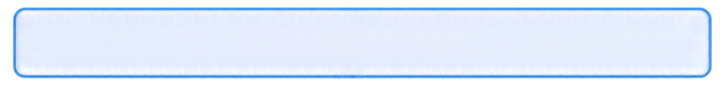

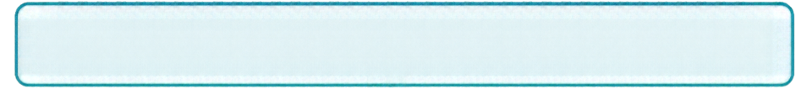

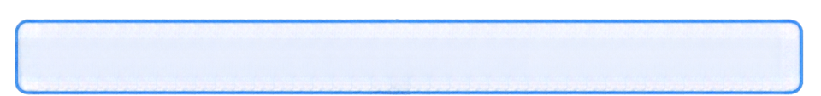

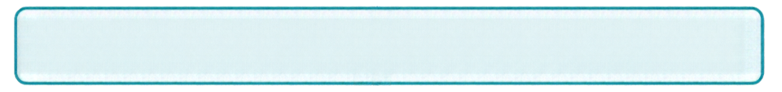

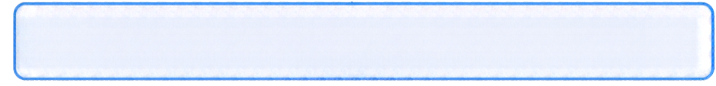

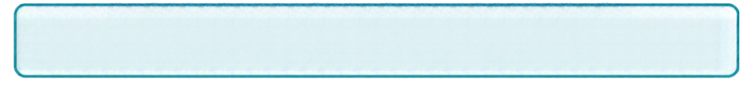
Architecture
[START] User opens NutriLens AI Web
1. User Authentication
2. Health Profile → Select Allergies (Nuts, Milk), Conditions (Diabetes), Diets (Vegan)
3. Food Label Capture
4. Computer Vision+OCR → OpenCV deskews &
enhances → Tesseract extracts text
5. Rule Engine Match → Matches ingredients against
user profile
6. Explaniable Verdict → Displays 🟢 SAFE / 🟡
CAUTION / 🛑 AVOID + Safe Alternatives

Slide 9
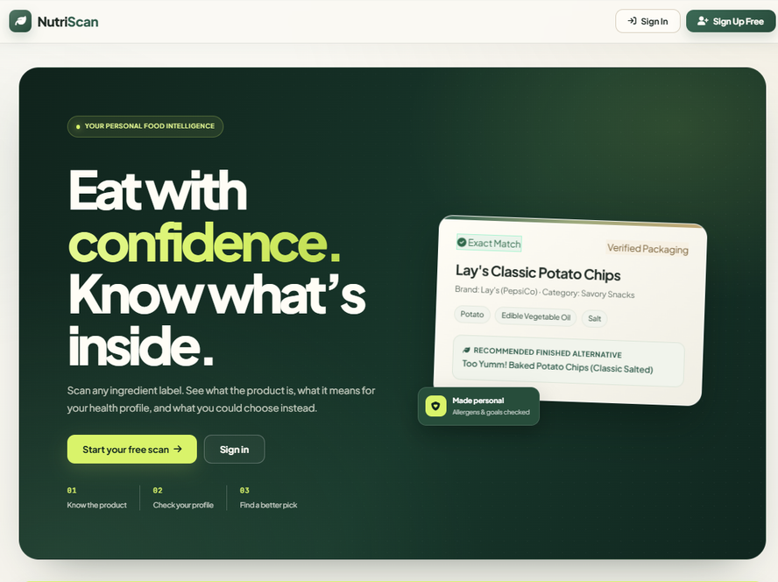
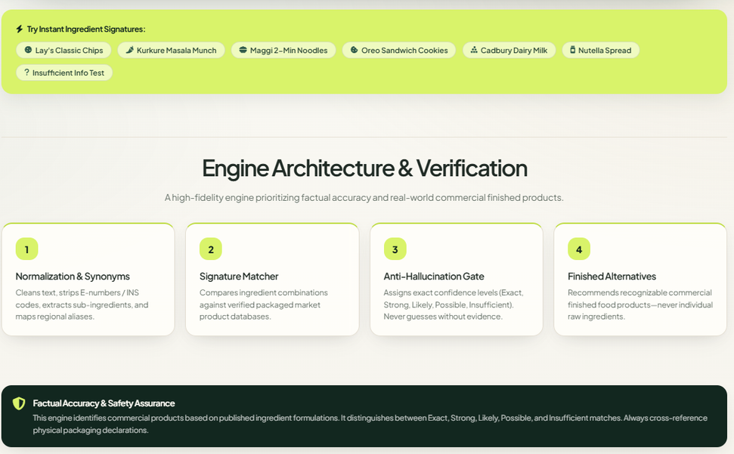
Execution

Slide 10
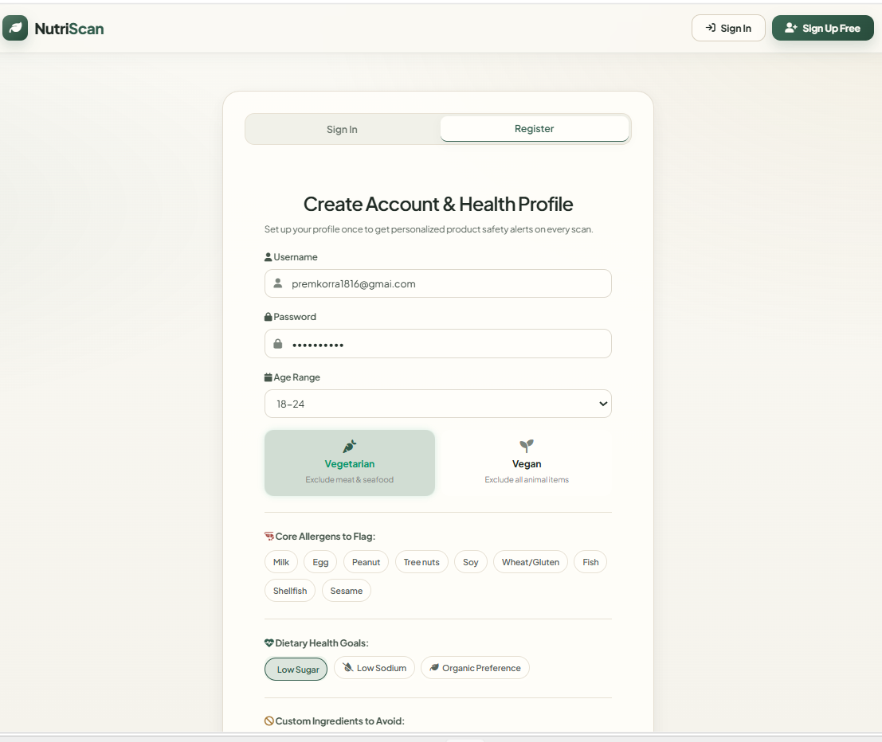
Execution - user profile

Slide 11
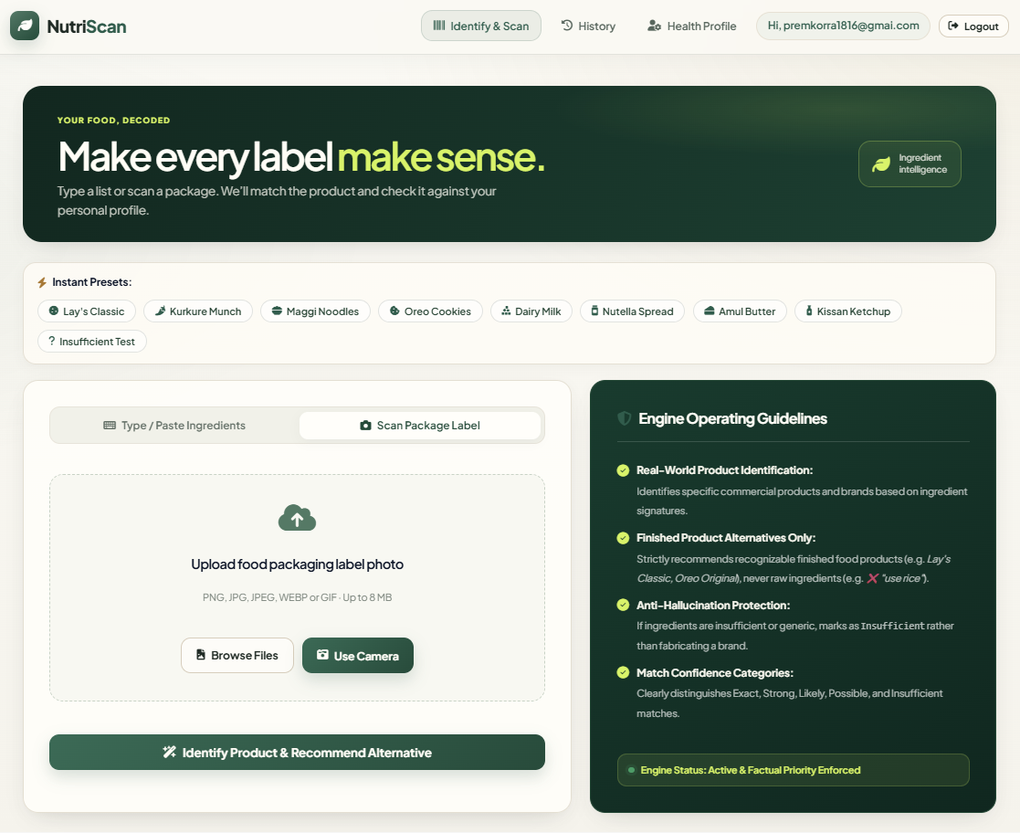
Execution - After registration

Slide 12
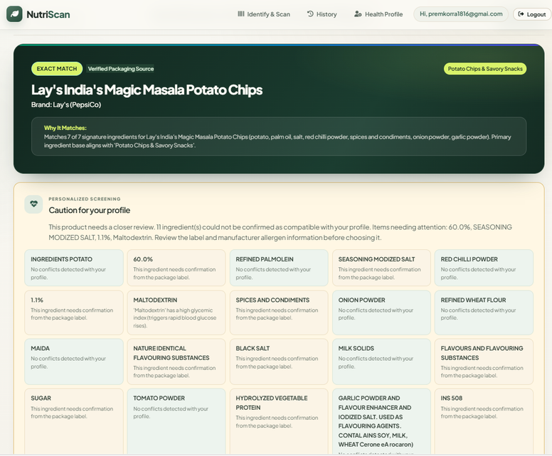
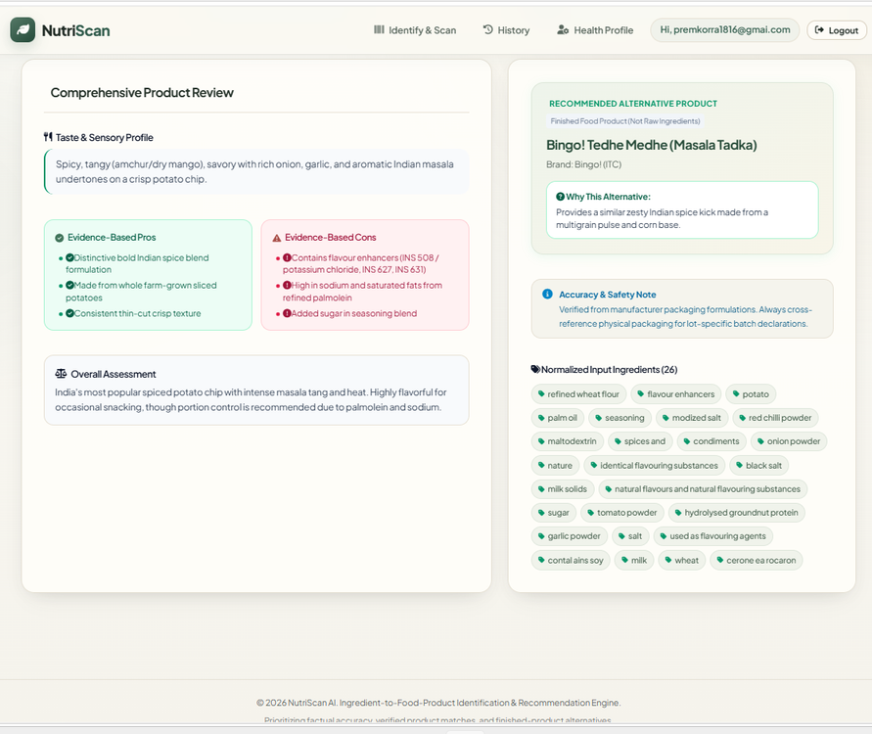
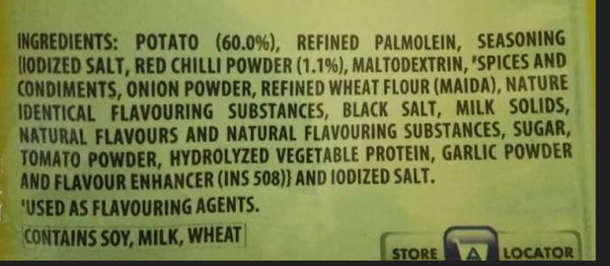
Output
Input Image

Slide 13
Conclusion
  Automated Food Label Analysis: Converts fine-print packaging into clear text using OpenCV & Tesseract OCR.
  Reliable & Zero Hallucination: Deterministic rule engine cross-referenced against 2,500+ verified ingredients.
  Instant Results: Delivers personalized verdicts (SAFE / CAUTION / AVOID)

